Slide 1
EXIT THE PLUG-IN Project
Team Details: Medha Goel(2210991915)
Mehak(2210991916)
Mehak Budhiraja(2210991917)
Mehak Sharma(2210991918)
Faculty Coordinator: Mrs. Sonam Mittal
:
Chitkara University Institute of Engineering and Technology,
Chitkara University, Punjab

Slide 2
Table of Contents
Introduction
Problem Statement
Technical Details
Key Features
Project Highlights
Conclusion
References/Links used

Slide 3
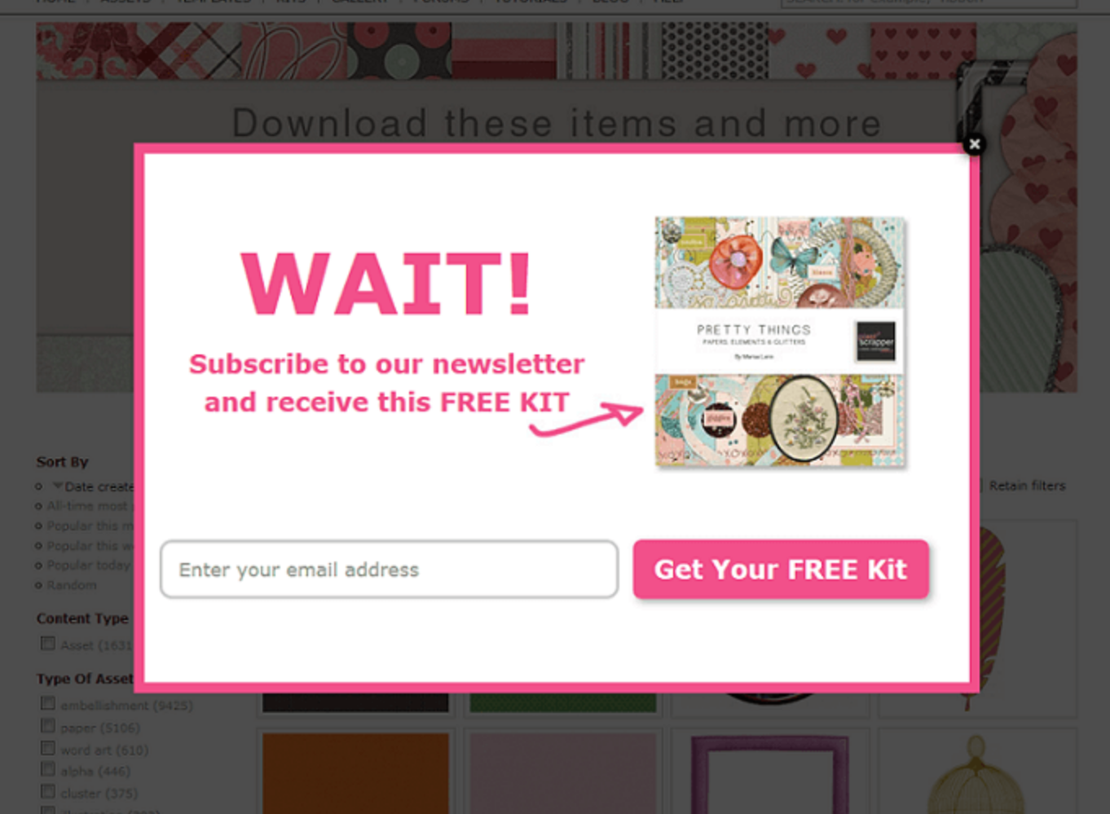
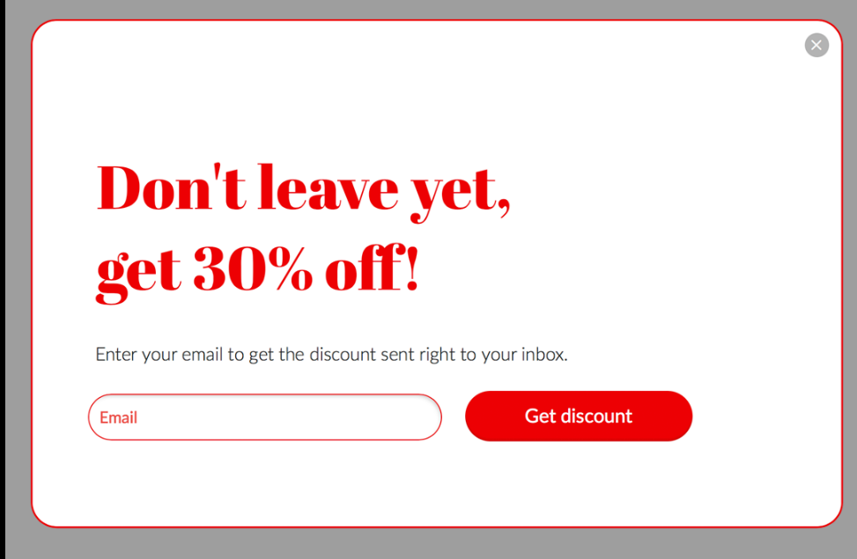
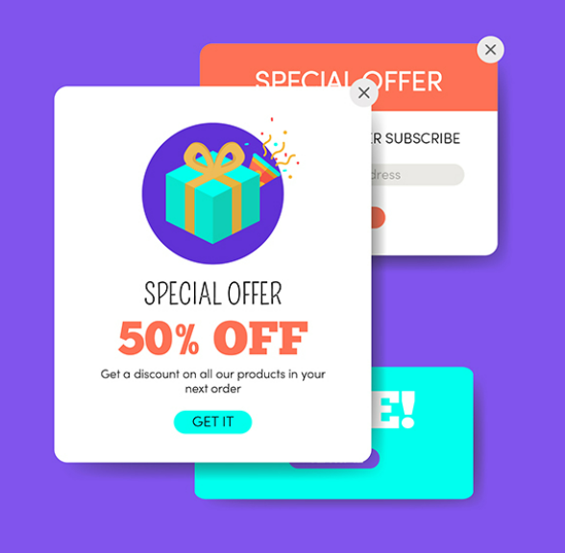
Introduction
Exit widgets are used to capture the attention of website visitors who are about to leave a website or close a tab. These widgets provide a last-ditch effort to retain the visitor's attention and prevent them from leaving the website. This project helped us to make an exit widget and a pop-up ad on our website.

Slide 4
Problem Statement
Many users struggle to exit a specific web browser plugin, resulting in frustration and lost productivity.
This project aims to develop a user-friendly web interface that allows users to easily and efficiently exit the plugin, improving their overall browsing experience.
The project helps the user to leave the interface of the site and redirects the user to the google homepage .
The project is to be made such that whenever we hover away from website page a pop up appears that asks the user either he wants to leave the page or continue working on it .

Slide 5
Technical Details
Knowledge about exit plugs is also important to implement this project with visual studio code as text editor.
The exit plugin is a software application that is typically built using various technologies and programming languages. The following are some of the basic technical details of the system:
1. Programming Languages: The system is typically built using programming languages such as HTML, CSS, JavaScript .
2. User Interface: The system typically has a user-friendly interface that allows users to access and manage various features and functionalities of the system.

Slide 6

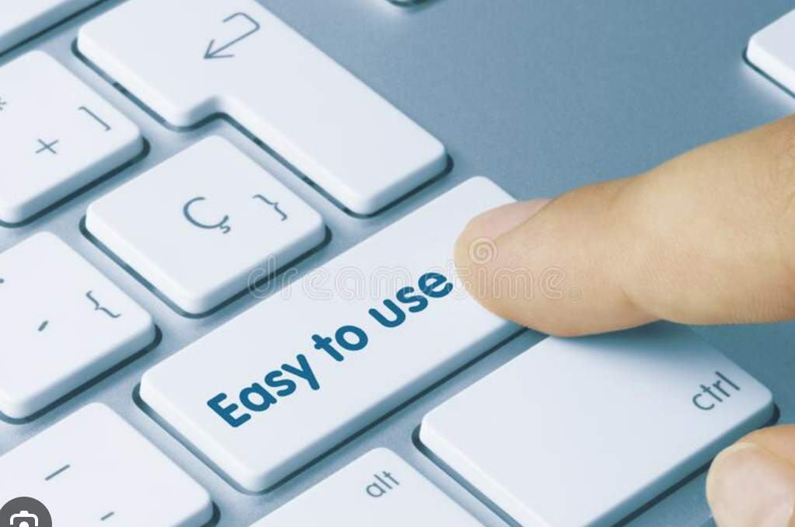


Key Features
The key features of a exit plugin include:
Targeting: An advanced popup software should offer advanced audience targeting and personalization features.
Ease of use : Prefer plugins that have a user-friendly interface and easy to use.
Interactive design : A wider range of templates available is better for customization and design as well as converting more.
Responsiveness : The site is responsive that means it can work on both laptop and mobile

Slide 7
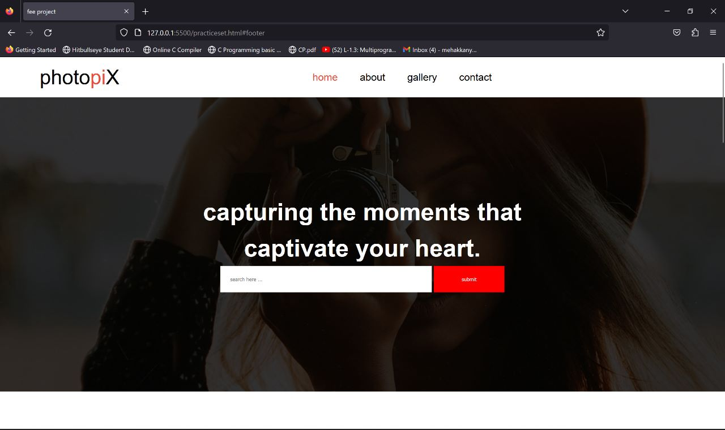
Project Highlights
Some website highlights are:

Slide 8
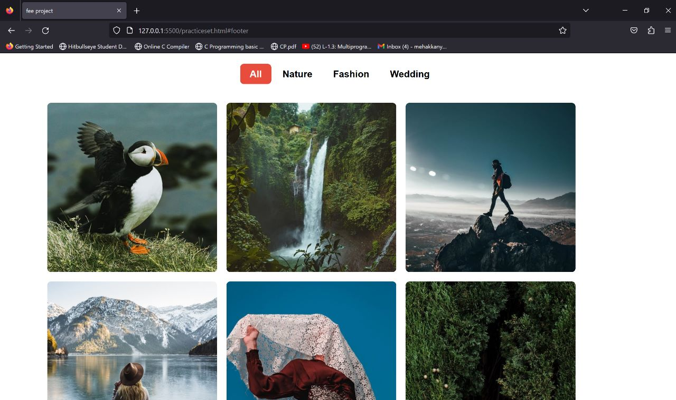

Slide 9
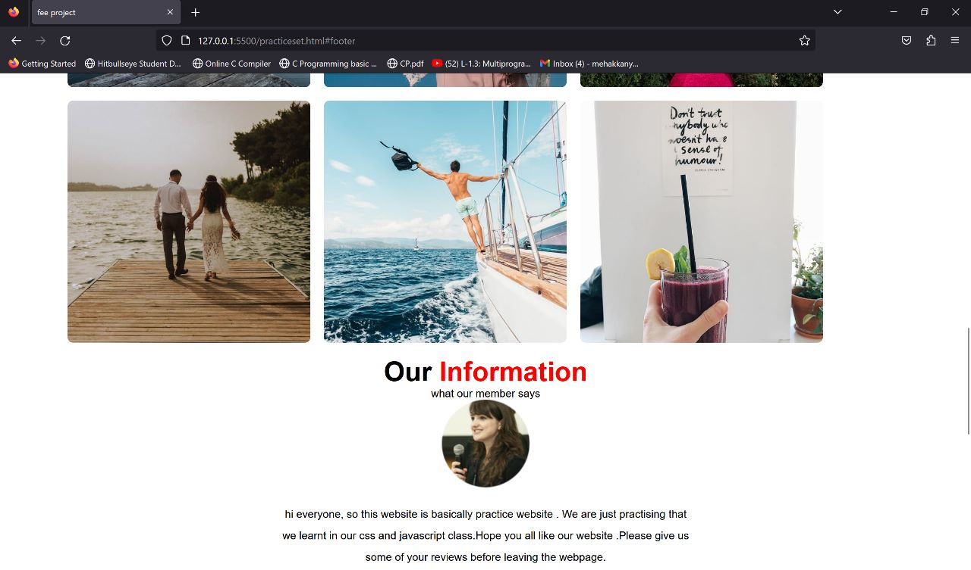

Slide 10
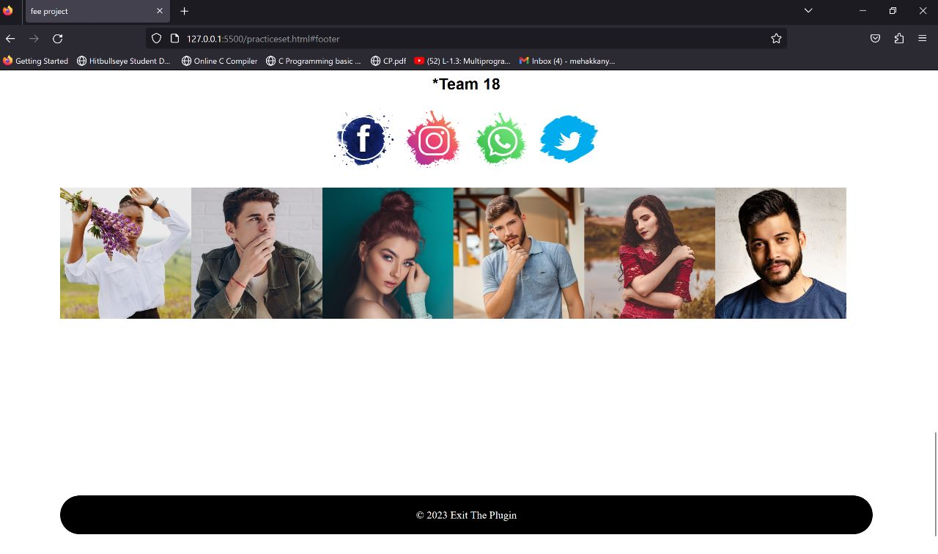

Slide 11
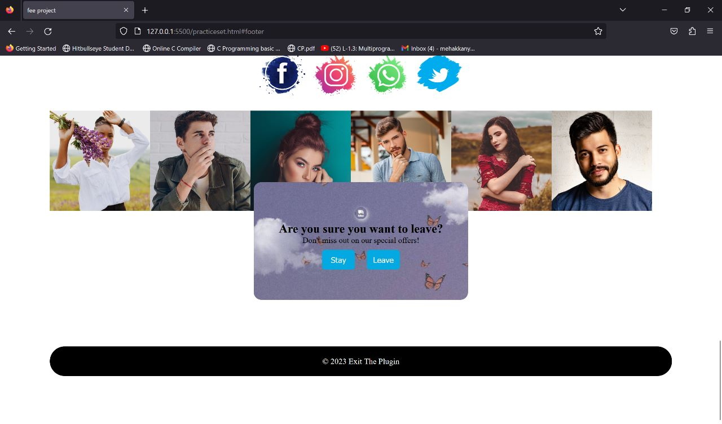

Slide 12
Conclusion
This project helped us to learn the correct use of html ,css and javascript.
We learned many things such as inserting an exit plug, images, buttons , headers ,footers , animations, forms, grids on our website through the project.
Thus , we can conclude that exit plugin is helpful to us in many ways. It attracts the user when they are about to leave the website and increases the time for the user to spend on the website by offering many special and attractive ideas and pop-ups.
In future , this plugin can be used on various websites to advertise their goods and offers to the customers , which can lead to increase of sale .

Slide 13
References/Links used
https://google.com/
https://youtube.com/
https://gfg.com/
4. https://W3school.com/

Slide 14


